Slide 1
MySQL BASICS
Diego Silva

Slide 2
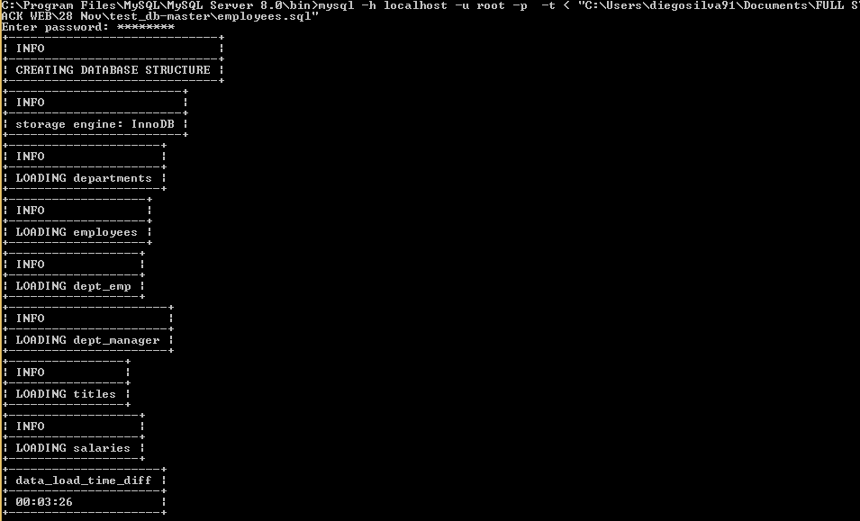
How to import a database?
Open CMD.
CD to the directory where is the file mysql.exe in folder.
Write mysql -h servername -u username -p -t < "dir_file\name_file.sql”. If the user has pass, write it else leave the field empty and press enter.
Ensure the file is on the directory name.

Slide 3
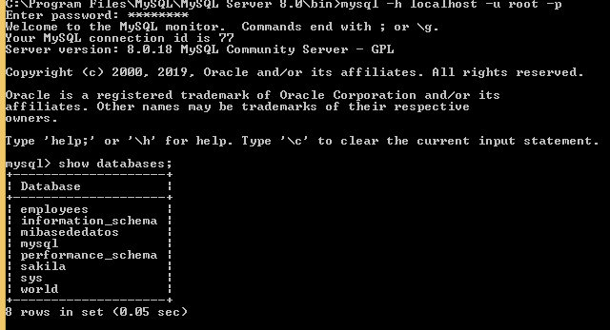
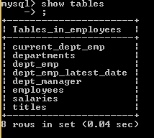
How to make inquiries?
Connect to MYSQL.
Access to MYSQL.
Write in command line
mysql –h servername -u username –p.
If the user has pass write it else leave the field empty and press enter.
Write
Execute the query you want.
show databases;
use name_database;

Slide 4
What kind of queries exist and their syntax
Sentences that can be used to perform various tasks.
Depending on the tasks, these sentences can be classified into three main groups (DML, DDL, DCL)

Slide 5
What kind of queries exist and their syntax

Slide 6
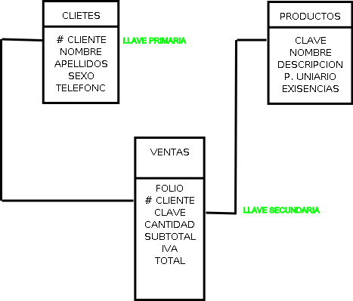
What kind of keys exist?
We can create restrictions to ensure the integrity of the data stored in our tables.
These restrictions can be implemented at the time of creating our tables or modifying them.
Require a unique name composed of the name of the scheme to which it belongs and the name that identifies it.
The different types of restrictions that exist are:
PRIMARY KEY.
UNIQUE.
FOREIGN KEY.
CHECK.
DEFAULT.
SchemaName.restrictionName.

Slide 7
PRIMARY KEY.
It is the most common of all.
To be a relational database its tables must always have a primary key to identify that row than others.
It is possible to add more columns as part of a primary key
PRIMARY KEY.
UNIQUE.
FOREIGN KEY.
CHECK.
DEFAULT.

Slide 8
What kind of data exists and what is each used for?

Slide 9
What kind of data exists and what is each used for?

Slide 10
What is a collation, such as utf8_general_ci or utf8_spanish_ci and what are its differences
Def. refers to a set of rules that determine how data is sorted and compared. Character data is sorted using rules that define the correct character sequence, with options for specifying case-sensitivity, accent marks, kana character types and character width.
These two collations are both for the UTF-8 character encoding.
The main difference is in how text is sorted and compared.
utf8mb4_unicode_ci is based on the official Unicode rules for universal sorting and comparison.
which sorts accurately in a wide range of languages.
Utf8mb4_general_ci is a simplified set of sorting rules which aims to do as well as it can while taking many short-cuts designed to improve speed.
It does not follow the Unicode rules.
It result in undesirable sorting or comparison in some situations, such as when using particular languages or characters.

